Slide 1
Project Management

Slide 2
What is Project Management?
Project : A group of milestones or phases, activities or tasks that support an effort to accomplish something
Management : is the process of Planning, Organizing, Controlling and Measuring

Slide 3

Project...
A collection of linked activities, carried out in an organised manner,with a clearly defined START POINT and END POINT to achieve some specific results desired to satisfy the needs of the organisation at the current time

Slide 4
Project Management
A dynamic process that utilises the appropriate resources of the organisation in a controlled and structured manner, to achieve some clearly defined objectives identified as needs.
It is always conducted within a defined set of constraints

Slide 5
Importance in Engineering:
Ensures timely delivery of software/hardware projects.
Balances scope, cost, and time (the triple constraint).
Enhances teamwork, communication, and risk control.

Slide 6
Characteristics of a Project
Temporary with a defined start and end.
Unique deliverables (software product, system, research prototype, etc.).
Progressive elaboration (detailed planning evolves with project progress).
Involves multiple stakeholders.

Slide 7
What does Project Management Entail?
Planning: is the most critical and gets the least amount of our time
Beginning with the End in mind-Stephen Covey
Organizing: Orderly fashion (Contingent/Prerequisites)
Controlling: is critical if we are to use our limited resources wisely
Measuring: To determine if we accomplished the goal or met the target?

Slide 8
Measuring…….
Are we efficient?
Are we productive?
Are we doing a good job?
What is the outcome?
Is it what we wanted to be?
If you can’t plan it, You can’t do it
If you can’t measure it, you can’t manage it

Slide 9
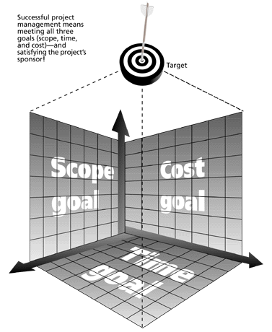
The Triple Constraint of Project Management

Slide 10
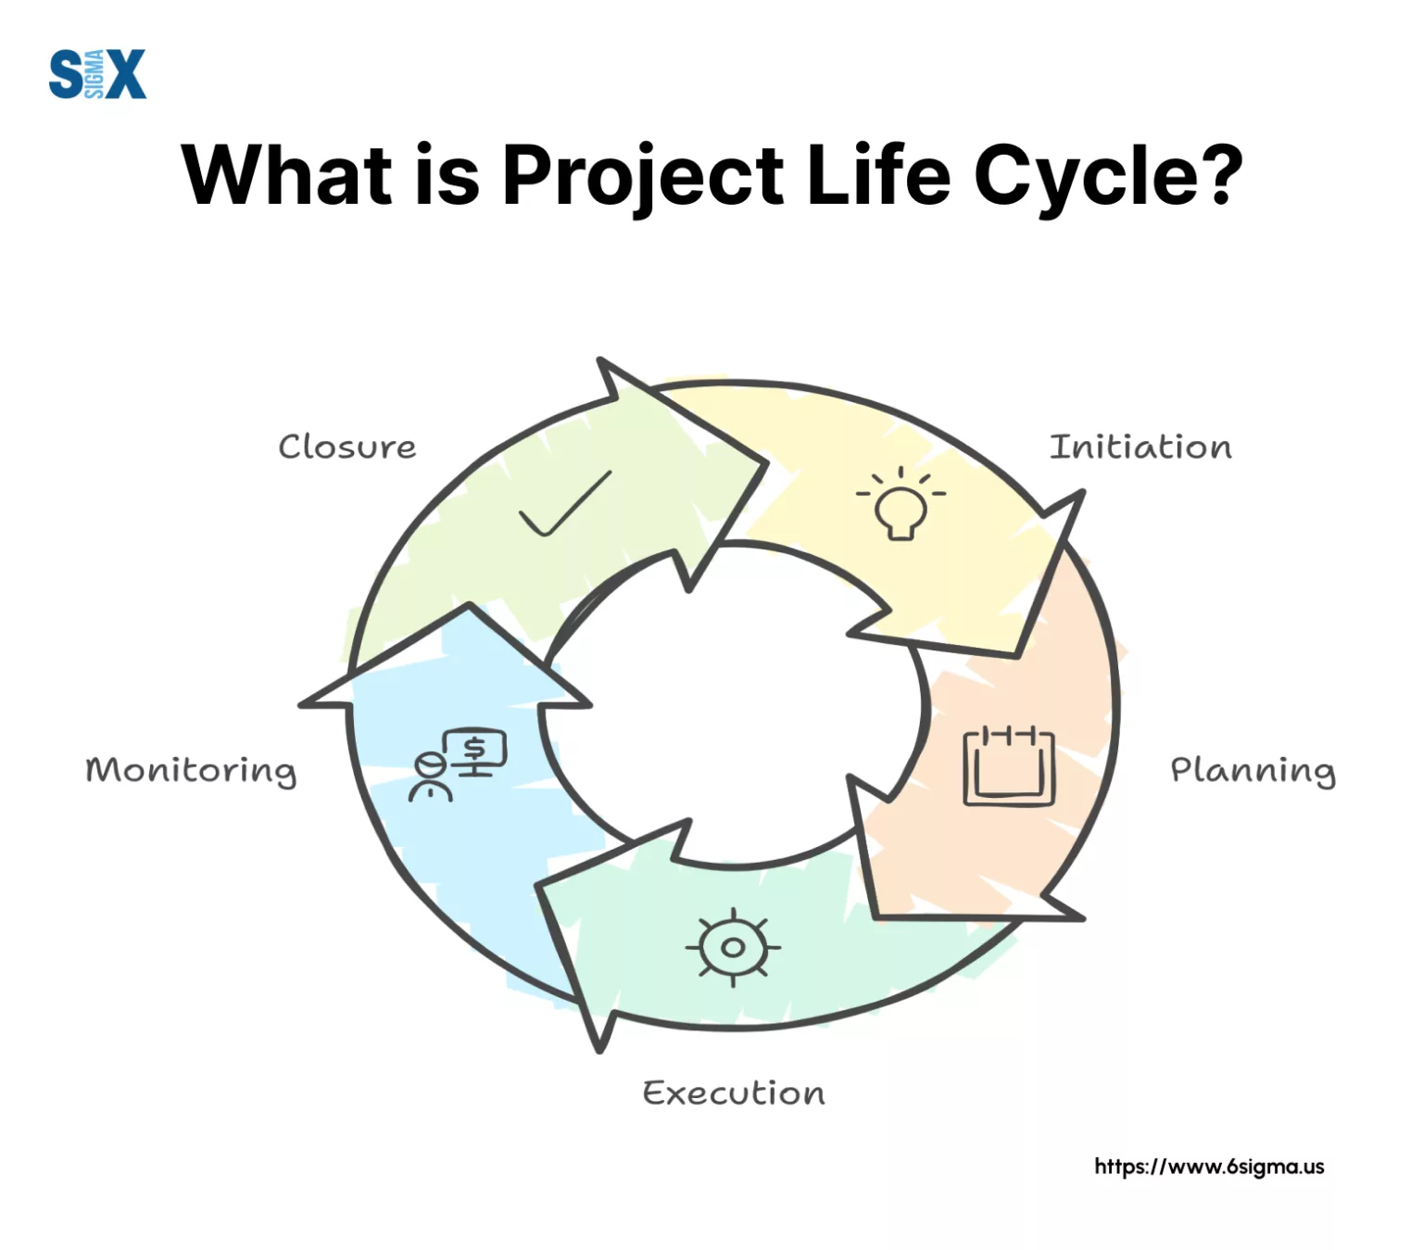
PROJECT LIFE CYCLE

Slide 11
Initiation – Define goals, feasibility, and stakeholders.
Planning – Develop project scope, WBS (Work Breakdown Structure), schedule, cost estimation, and risk management.
Execution – Carry out planned tasks, allocate resources, ensure team collaboration.
Monitoring & Controlling – Track performance using KPIs, manage risks, adjust plans.
Closure – Deliver final product, evaluate performance, document lessons learned.

Slide 12
Who uses Project Management?
Nearly Everyone to some degree
People plan their Days, their Weeks, their Vacations and their Budgets and keep a simple project management form known as ‘’To Do’’ list
Any Process or Means used to track tasks or efforts towards accomplishing a goal could be considered Project Management

Slide 13
Why is Project Management used?
It is necessary to Track or Measure the progress we have achieved towards a Goal we wish to accomplish
We use Project Management to Aid us in Maximizing and Optimizing our resources to accomplish our goals

Slide 14
How much time does Project Management take?
Not much. Probably more time is wasted as a consequence of lack of Project Management tool than is spent to Plan adequately, Organize, Control effectively and Measure appropriately
How long: As long as there are things to do

Slide 15
Why is Project Management Important?
Enables us to map out a course of action or work plan
Helps us to think systematically and thoroughly
Unique Task
Specific Objective
Variety of Resources
Time bound

Slide 16
Project Management Processes (PMBOK Guide)
Integration Management – Ensures coordination of all processes.
Scope Management – Defines boundaries of work.
Time Management – Scheduling (Gantt charts, CPM, PERT).
Cost Management – Budgeting and resource allocation.
Quality Management – Ensures product meets standards (ISO, CMMI).
Human Resource Management – Team roles, leadership, motivation.
Communication Management – Stakeholder reporting, progress updates.
Risk Management – Identify, analyze, mitigate risks.
Procurement Management – Handling contracts and external vendors.

Slide 17
Project Management Tools & Techniques
Traditional Tools:
Gantt Chart, CPM (Critical Path Method), PERT (Program Evaluation Review Technique).
Agile & Modern Approaches:
Scrum, Kanban, Extreme Programming (XP).
JIRA, Trello, MS Project for tracking.
Software Engineering Specific:
Version control (Git), CI/CD pipelines, automated testing.

Slide 18
Advantages
In built Monitoring/ Sequencing
Easy and Early identification of Bottlenecks
Activity based costing
Identification and Addition of missing and new activities
Preempting unnecessary activity/expenditure
Timely Completion
Assigning tasks
Reporting

Slide 19
Road to Better Project Management
Find a Project plan that fits your style of project management needs
It may be as simple as creating templates, forms and spreadsheets to track tasks
Formation of a Project Management committee
Listing out all the tasks and sub-tasks to accomplish a goal
Jot down the time period and person responsible against each task/sub-task

Slide 20
Road to Better Project Management
Identify a Project Manager
Identify Task Managers
Sequence the activities in relation to time period
Present to the PMC
Finalize by reaching an agreement and start work…...

Slide 21
Implementation
Regular Monitoring
Resource Support
Critical issues discussed and solution
Meeting with the team on completion of each major milestone
Track the progress against the plan
System to add/delete tasks in the PMT

Slide 22
Consequences of not using PMT
    DELAY
    COST
    WASTE OF RESOURCES
    QUALITY
    DISSATISFACTION
    REPUTATION

Slide 23

Project Management….
Work Smart Not Hard !!!

